Slide 1

SENIOR PROJECT
AI project with Multithreading

Slide 2


AGENDA
Introduction
Project Idea
Motivation
Build Target
What’s Different?
Project Features
Target Audience
Prototype
Project Output

Slide 3
INTRODUCTION
Minjang Jin, the Game programming student in LaSalle college
South Korea
No career, started programming A-Z in the college
Favorite things: Drawing, and playing Real-time strategy games
C++, C#, and Python

Slide 4
PROJECT IDEA
Main idea: Multithreading utilization
Usage of thread: How influence would the implementation of multithreading be given?
What part will I utilize thread for?
Third-person perspective to observe AI’s behavior
Unity engine, and C# language
Direction: Implementation the combination of pathfinding and state machine with multi-threading techniques.

Slide 5
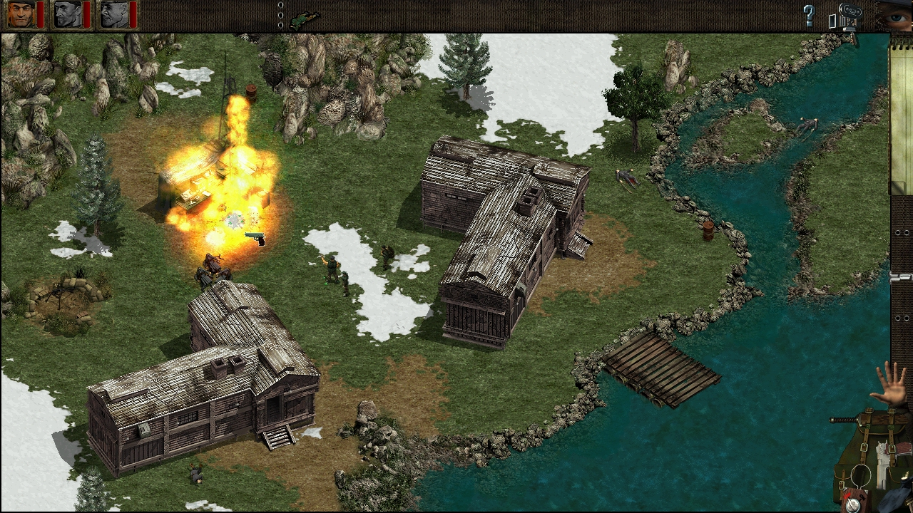
MOTIVATION
Your motivations to build this project
Study multithreading – Senior research
Actual performance instead of using Unity engine
Curiosity for thread work
Main motivation: Commandos 1

Slide 6
BUILD TARGET
Build Details
Platform: | PC
O.S: | Windows
Camera: | Third
Genre: | Real-Time Strategy

Slide 7
WHAT’S DIFFERENT?
Differences
Provide opportunity of observation for comparison
Thread pool VS Task pool
Give the output with thread techniques
Speed, FPS, and time
Thread Keywords: Thread, AutoResetEvent, volatile, Lock, Monitor… etc
Game experience: Stealth game
Sight interaction; detect an object, and change behavior
Notes:
Volatile- indicates that a field might be modified by multiple threads that are executing at the same time.
Lock - ensures that one thread is executing a piece of code at one time. The lock keyword ensures that one thread does not enter a critical section of code while another thread is in that critical section.
Monitor - Monitor is no different from lock but the monitor class provides more control over the synchronization of various threads trying to access the same lock of code.

Slide 8



PROJECT FEATURES
Features
Pathfinding – Astar, and DFS(Depth-first search)
State machine
Idle – It is the state of waiting until taking an order
Find – It is the state of looking around to find out an object
Walk – It is the state of walking to move the position with pathfinding
Perception (visual sensor) – observing an object visually. It is interacting with the find state.
UI
Record the average time of how many does an entity activate pathfinding in thread or task
Real-time, but some features are locked by AutoResetEvent to print in every specific time
Notes:
Depth-first search (DFS) is an algorithm for traversing or searching tree or graph data structures. The algorithm starts at the root node (selecting some arbitrary node as the root node in the case of a graph) and explores as far as possible along each branch before backtracking.

Slide 9
PROJECT FEATURES
Features
Environment - Wall and Bush
Thread manager
Receive a request from an entity, then allocate and lock an order resource into the queue list. Afterwards one or many thread will work pathfinding synchronously.
Thread pool technique
Task manager
The same principle with thread, but firstly task manager will stack pathfinding action asynchronously, then one or many task works synchronously. (Keywords: async/await)
Notes:
Depth-first search (DFS) is an algorithm for traversing or searching tree or graph data structures. The algorithm starts at the root node (selecting some arbitrary node as the root node in the case of a graph) and explores as far as possible along each branch before backtracking.

Slide 10
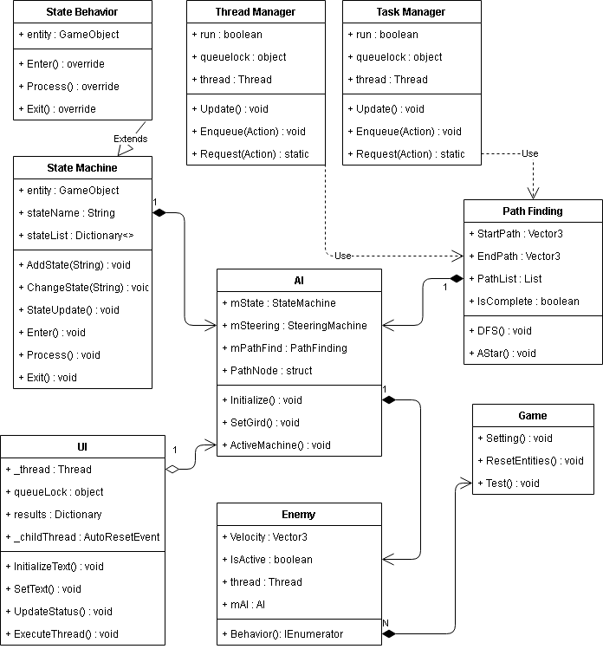
PROJECT FEATURES

Slide 11
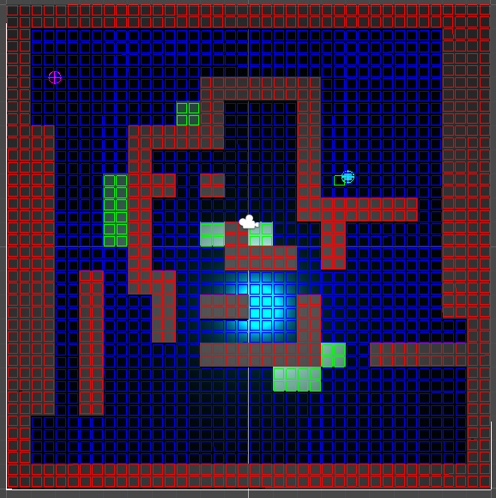
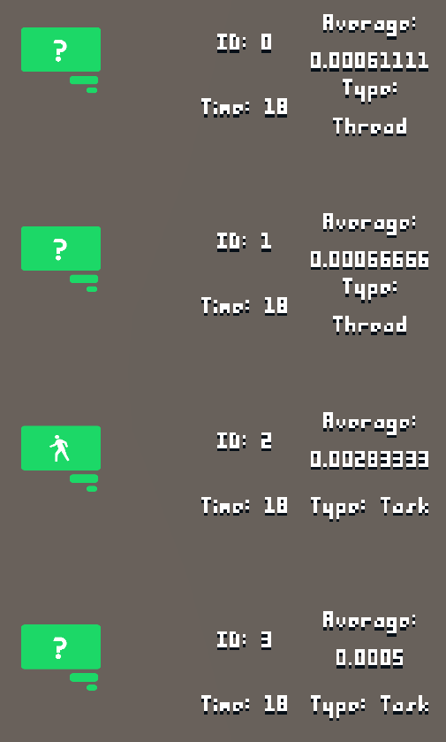
PROJECT FEATURES
Find
Idle
Walk
Grids for Pathfinder
State machine
UI
Notes:
Depth-first search (DFS) is an algorithm for traversing or searching tree or graph data structures. The algorithm starts at the root node (selecting some arbitrary node as the root node in the case of a graph) and explores as far as possible along each branch before backtracking.

Slide 12
TARGET AUDIENCE
What is your target audience?
Programmers, who have curiosity of how Multi-threading activates
Game designers, who desire to implement Stealth game, or Real-time strategy game

Slide 13
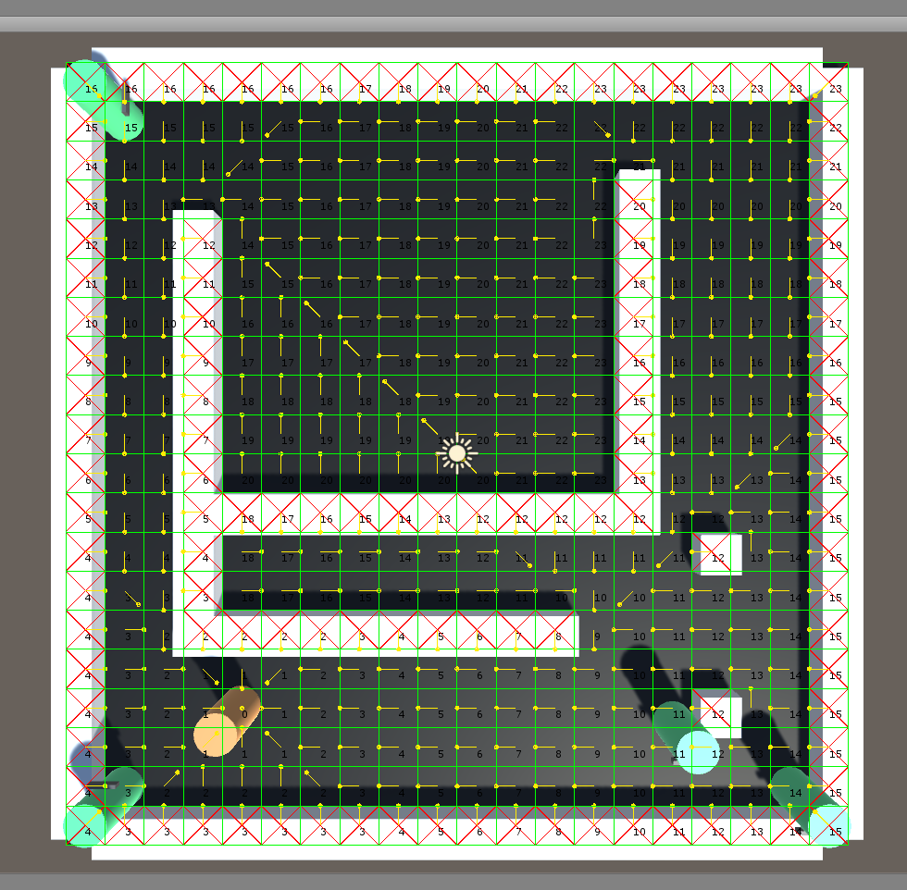
PROTOTYPE

Slide 14
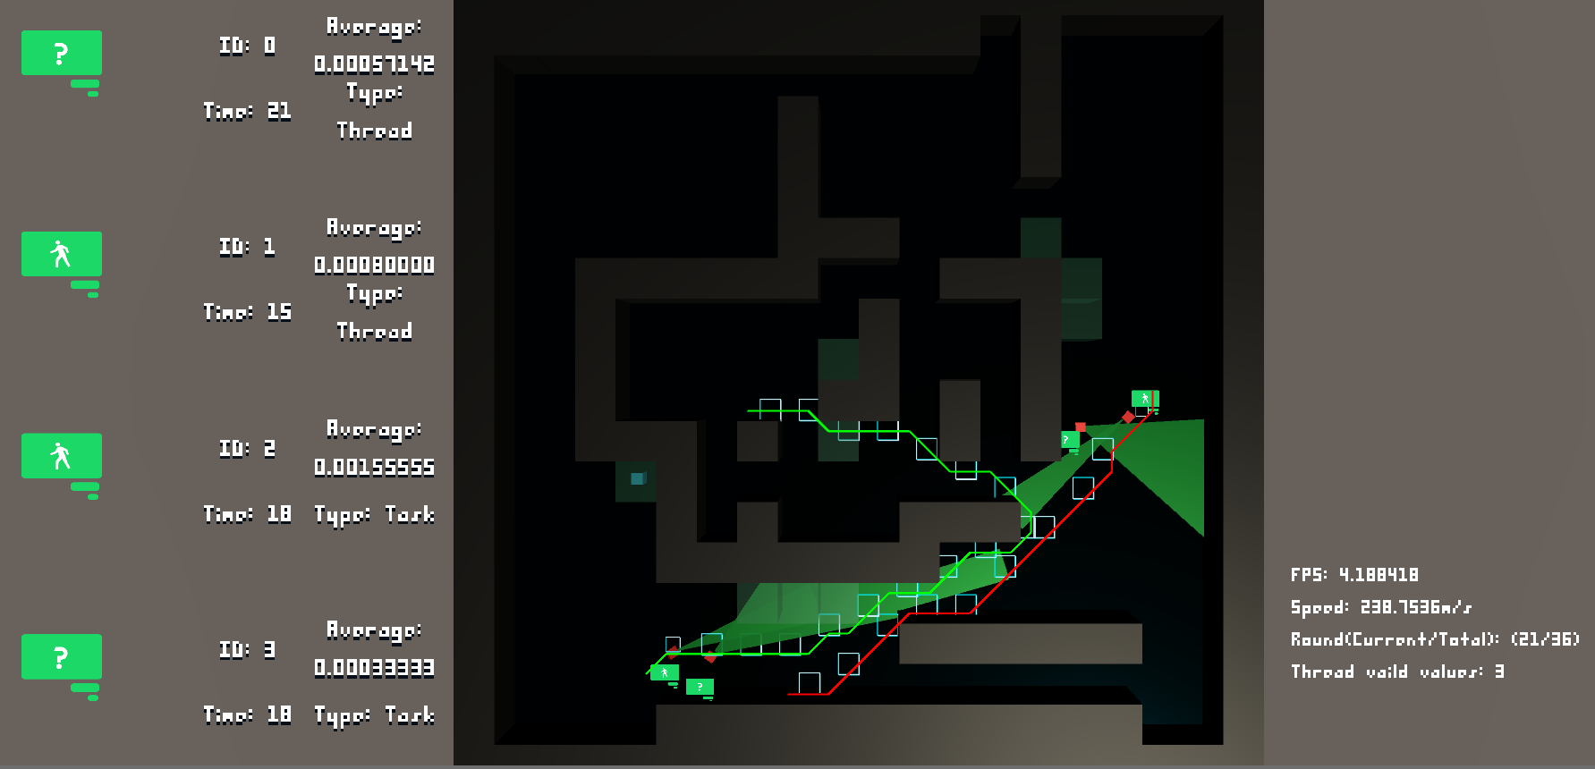
PROJECT OUTPUT

Slide 15
PROJECT OUTPUT

Slide 16

THANK YOU
Don’t ask girlfriend

